Slide 1
Relational Database Modelling
420-D10 Database I – S05
References:
https://en.wikipedia.org/wiki/SQL

Slide 2
Reference
http://databases.about.com/od/specificproducts/a/normalization.htm
Normalization, normal forms
http://www.datanamic.com/support/lt-dez005-introduction-db-modeling.html
Overall modelling

Slide 3
Objectives
Define the process on going from a business requirement to an implemented database
You’ve played with databases on Oracle
How did the data get there?
How was it designed?
Defined tables, fields, keys, data types

Slide 4
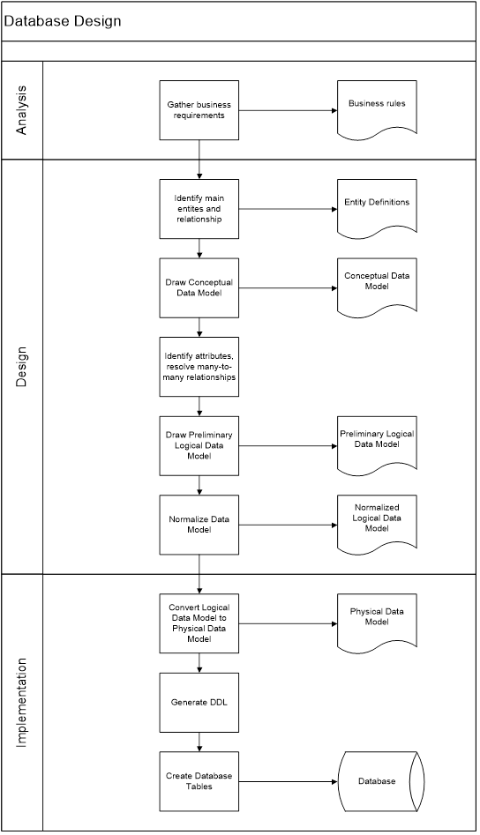
Big Picture
Analysis
Design
Implementation
Notes:
As part of this course, we will walk through each phase explaining the steps along the way

Slide 5

Modelling
What is “modelling” in computer science?
We will be focused on “data modelling”
Notes:
Ask: What do we mean by modelling?
Hint: those aren’t “data models” in the diagram

Slide 6
Modelling
Data modelling
Process of create a representation of the users’ view of the data
Data structures and their characteristics, relations, constraints and transformations
Communication tool between the systems designer, developers and business professionals
Notes:
Consider talking about a house without an architect’s plan or a drawing of what it’s supposed to look like?

Slide 7
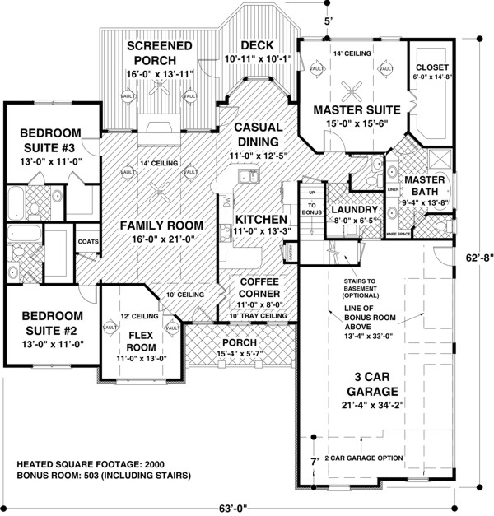
Modelling
Analogy
Consider an architect’s house plan
Communication tool
Everybody has a common view
Notes:
Consider talking about a house without an architect’s plan or a drawing of what it’s supposed to look like?

Slide 8
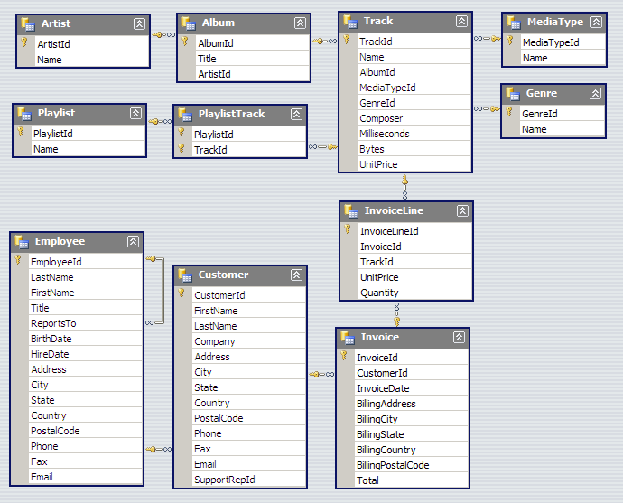
Sample Data Model
A digital media store
Tables for:
artists,
Albums
Media tracks
Invoices
Customers
Employees
Notes:
In class: ad hoc walk through on how to read this
More/formal details to follow later in the course.
In class exercises for groups to walk through and interpret this. (tbd)
According to the model:
Is Genre a unique attribute to an album? What is a benefit from the current model?
Which table would you go to to figure out how many employees there are?
How do you figure out who the manager of any specific employee is?
How to figure out how many seconds of music is on an album?
Can Customers buy a playlist, album or track?
Can a customer have more than one email address stored in the database?
How can you determine when a certain customer last purchased something?
How can you determine what the number one selling track for all time is?
How can you have multiple artists on a single album or track?
Can you have the same track on multiple albums (re-release “Best hits of ….”)

Slide 9
Course plan
How to go from business requirements to the design of these tables?
Notes:
What we’ll be doing for the next couple of weeks.

Slide 10
Data Modelling is important
Bad data model = bad application design/implementation
Consider the data structures that you learnt in prior classes
do the make a difference?
If the data model can not accommodate a business requirement ?
Go back to the questions used to exercise the data model on previous slides and reconsider
Notes:
This course is a bit different than some of your other computer science courses
More modelling and analysis (less coding, execution and test)
More theory and design
Go back to Chinook database and determine what the shortcoming were. Brainstorm as a class and determine if they are biz requirements and how you’d change the model.
Imagine if you had to tell the business owner that you couldn’t do something because of the data model? (i.e. an album can’t have more than one artist vs a customer can’t have more than one email)
You have to make SOME simplifying assumptions, just don’t pick ones that prohibit desirable business rules.
Which is why, like most things in ANY design process, we must gather requirements so that we can design and test the data model.

Slide 11
Big Picture
Analysis
Design
Implementation
Notes:
What do I mean by design AND testing the data model against the business requirements?
Test the use cases against the data model. Ensure the data model supports the use case:
As a customer, I want to…
As an employer, I want to ….

Slide 12
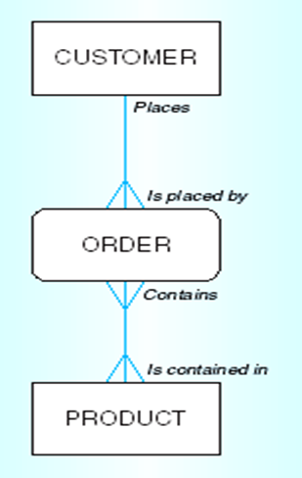
Modelling
Humans understand diagrams better than plain text
Entity Relationship Diagram
ERD
A common tool for initial modelling
DBMS and technology indendent
Focus on the business first
Notes:
When we say “modelling” we will be drawing, using s/w tools

Slide 13

Modelling: Key diagrams you’ll learn to love
Conceptual Data Model
Logical Data Model
Physical Data Model
Increasing complexity
Notes:
These diagrams aren’t independent of each other but a different growth phase. Like the metamorphosis of a caterpillar into a beautiful butterfly!
(Who says computer science isn’t poetic?! )
Following slides are overview and summary. We’ll go into much more excruciating detail on each step over the next couple of weeks. For now, soak in the big picture.
Different levels of (increasing complexity) which is why we start with the simpler Conceptual Data Model and flesh it out until we’ve got something that we can put onto the DBMS.

Slide 14
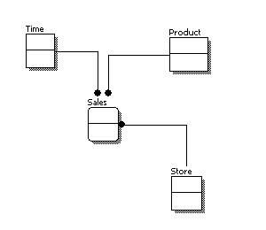
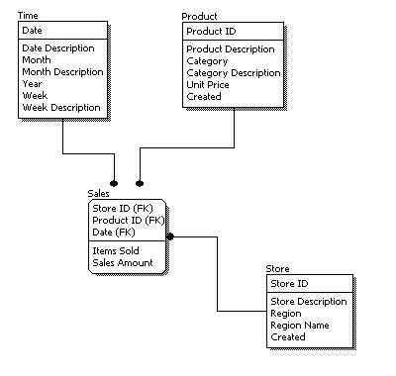
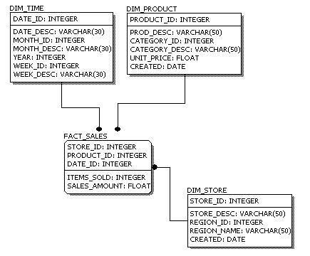
Modelling Diagram Samples
Conceptual Model Design
Logical Model Design
Physical Model Design
Notes:
We’ll see later why we can’t implement a conceptual data model in a RDBMS (it’s all in the normalization and key/table definition)

Slide 15
Comparison of data models
Feature | Conceptual | Logical | Physical
Entity Names | ✓ | ✓
Entity Relationships | ✓ | ✓
Attributes |  | ✓
Primary Keys |  | ✓ | ✓
Foreign Keys |  | ✓ | ✓
Table Names |  |  | ✓
Column Names |  |  | ✓
Column Data Types |  |  | ✓
Notes:
Source: https://www.1keydata.com/datawarehousing/data-modeling-levels.html
http://www.datamodel.com/index.php/articles/what-are-conceptual-logical-and-physical-data-models/

Slide 16
Goals of this process
Data model that
Meets the business needs
Is implementable on the RDBMS
Suited for the applications that use it

